Slide 1

NSS – Nebulas Stated Storage
Combining NVME, SSD, 100Gig and Above NIC and ARM, plus the software to make it all work

Slide 2
Problems
We need more storage, at lower cost, at higher speed, at low power, and low overhead.
First it’s a hardware problem:
Drives are small
Apps are closer to edge
Second it’s a “connection” problem:
Traditional solutions are hard-wired to a single node
We want the speed of local ssd’s but outside the server box
Pods need to move
Third, we need speed
To match the ssd we need high speed, high thruput, and low latency

Slide 3
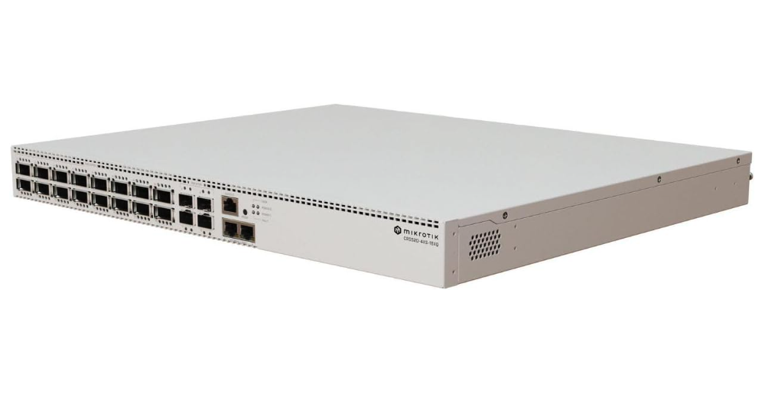
Connection – 100 Gig Ethernet
100 Gig switches price has fallen
100 Gig – 16 Port = $2000 - $125 a port
Mikrotik CRS520-4XS-16XQ-RM
100 Gig Nics pricing has fallen
NVME Over TCP has become widely supported, allowing for use over 100Gig networks

Slide 4
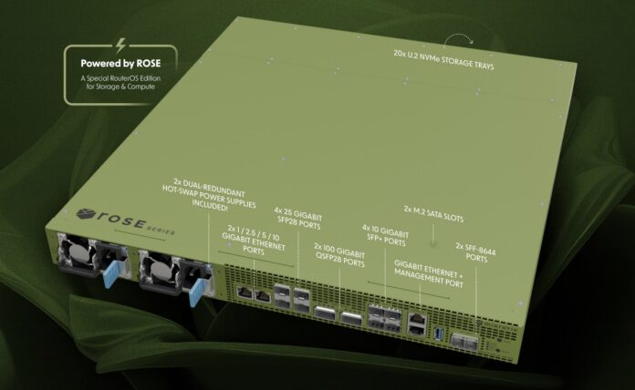
Storage Appliance
Where to put the drives?
New generation of storage appliances
100 Gig Network native
NVME over TCP Built IN
20 u.2 Drive slots for ssd’s
Can use 20 m.2 drives with adapter
Support for nvme over tcp
Support for RAID
Support for virtual drive export/thin provisioning
NFS Support
iSCSI support
Lower Power ARM

Slide 5
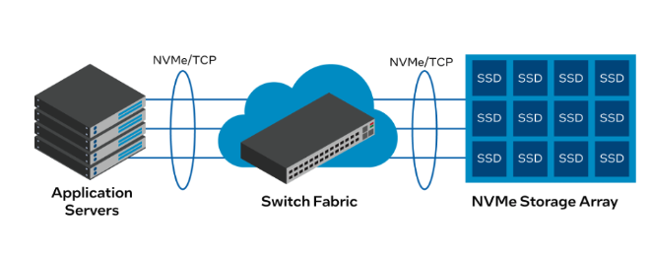
Why NVME Over TCP
NVME Over TCP – extends ssd drive level protocol to the network
Lower overhead than iSCSI
Possible to go directly to drive as network
Can be acerated/off-loaded for best thru-put
Supported by RHEL
Reference:
https://www.linkedin.com/pulse/nvmetcp-simplified-rajesh-dangi-1nvzc/

Slide 6
Next Generation OCP Storage
Storage Provisioner
Provisions disk on RDS with thin/thick
Allows movement pods from node to node
Support for:
Nvme Over TCP
iSCSI
NFS
Storage Manager – Containerized app on appliance
Provides REST api and gui for storage management
Additional Features:
Capacity Management across multiple appliances
Appliance Evac – Will require client container shutdown/restart
RAID support – Allow a host raid on ocp node to connect to 2 virtual volumes on possibly 2 different hosts, in different racks

Slide 7
Further Enhancement for telco
Registry for openshift install – As a container on the storage appliance (With optional redundancy of a second copy on a second node)
Tip to Ondrej Famera for already getting registry working on ARM/Pi
Offload of audit logs
Offload of stats
Minio Support – For backup of cluster

Slide 8
Where is the source:
https://github.com/glennswest/nvmetarget

Slide 9
Where / Why
RDS/NVME Over TCP – is idea for edge type deployment
Support for PV’s for apps

Slide 10
Components
Consists of:
Nvmetarget – Used for emulating mikrotik on linux host
Coded - Currently working for volume allocation
Storeman – A container that provides a gui for setup, and handles volume creation, and distribution of volumes – runs on storage node
Development started, WIP to integrate library, and table definition and gui for both standard and advanced features
Focus on nvme first
Mikrotik_csi – A ocp component, that handles pv requests
Development started, tested capture of pv requests, and working to that point, blocked on storeman work

Slide 11
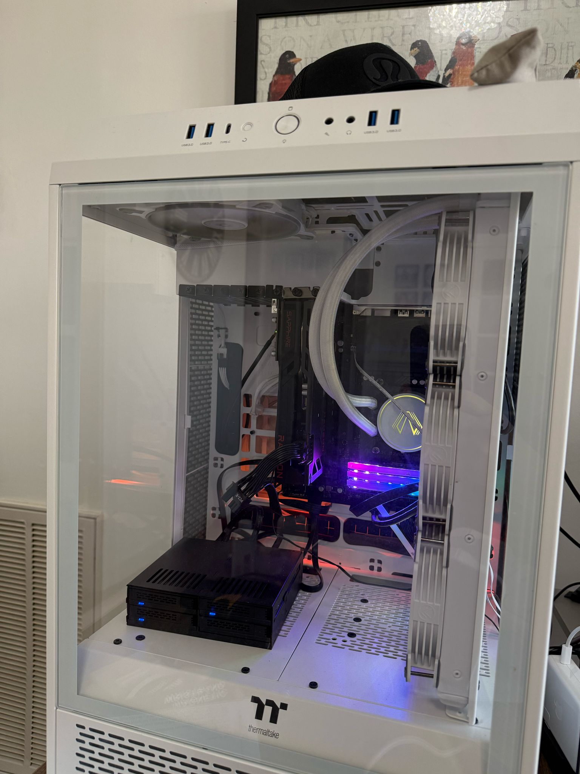
The Lab Setup
Current Lab:
Running on components virtual for software development.
A emulated ROSE appliance
Test RHEL Box to access emulated environment
Planned Lab:
Mikrotik ROSE Appliance with 20x1TB ssds (Using m.2 to u.2 adapter)
Mikrotik CRS520-4XS-16XQ-RM 16 Port 100 Gig Switch
100 Gig Nic in development server

Slide 12
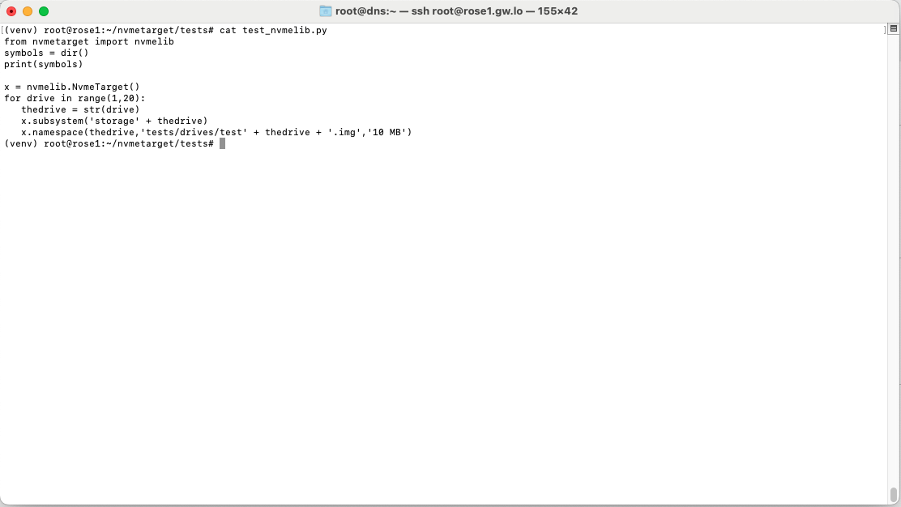

Slide 13
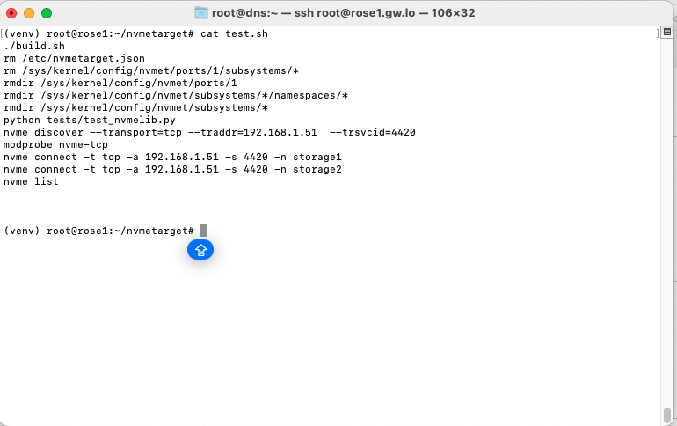

Slide 14
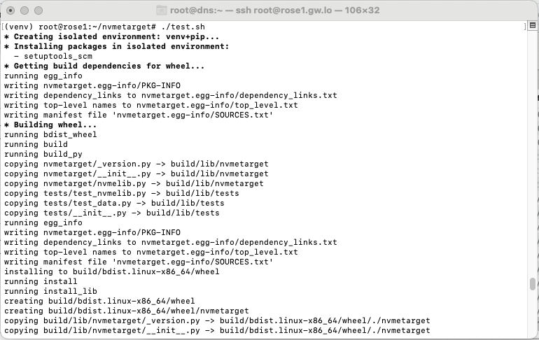

Slide 15
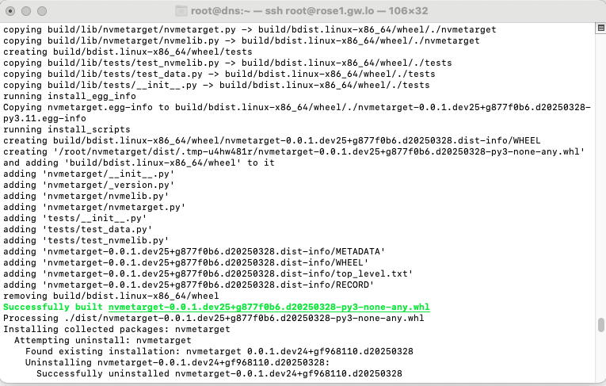

Slide 16
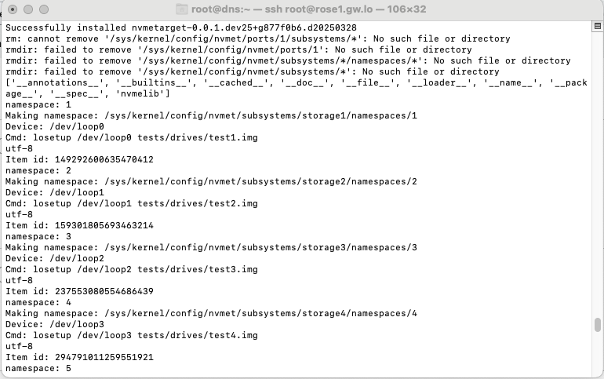

Slide 17
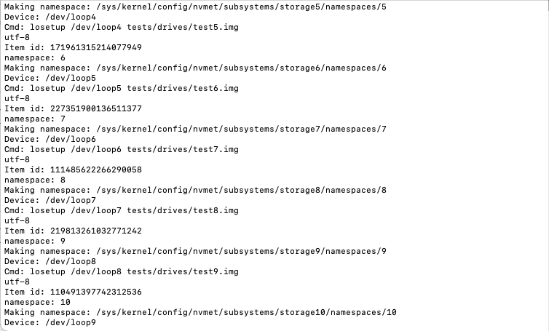

Slide 18
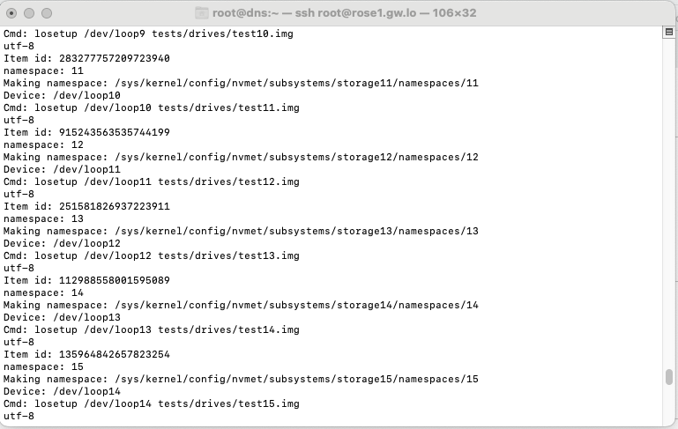

Slide 19
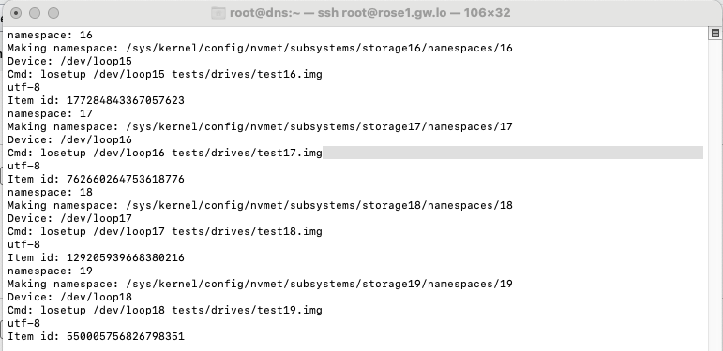

Slide 20
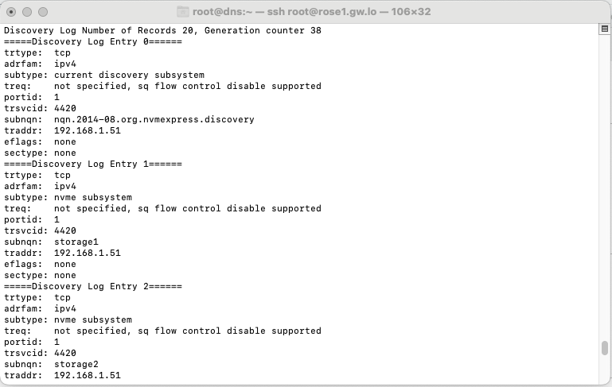

Slide 21
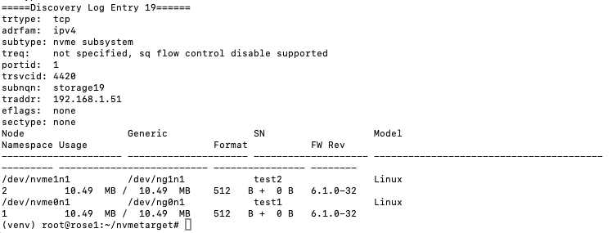

Slide 22
